Slide 1
What Changes in Life expectancy 2011-2020 reveal about US racial mortality inequality
Replication and extension of the paper: “Decomposing changes in life expectancy: Compression versus shifting mortality”
Wen Su
U6897805
EMET 8002

Slide 2
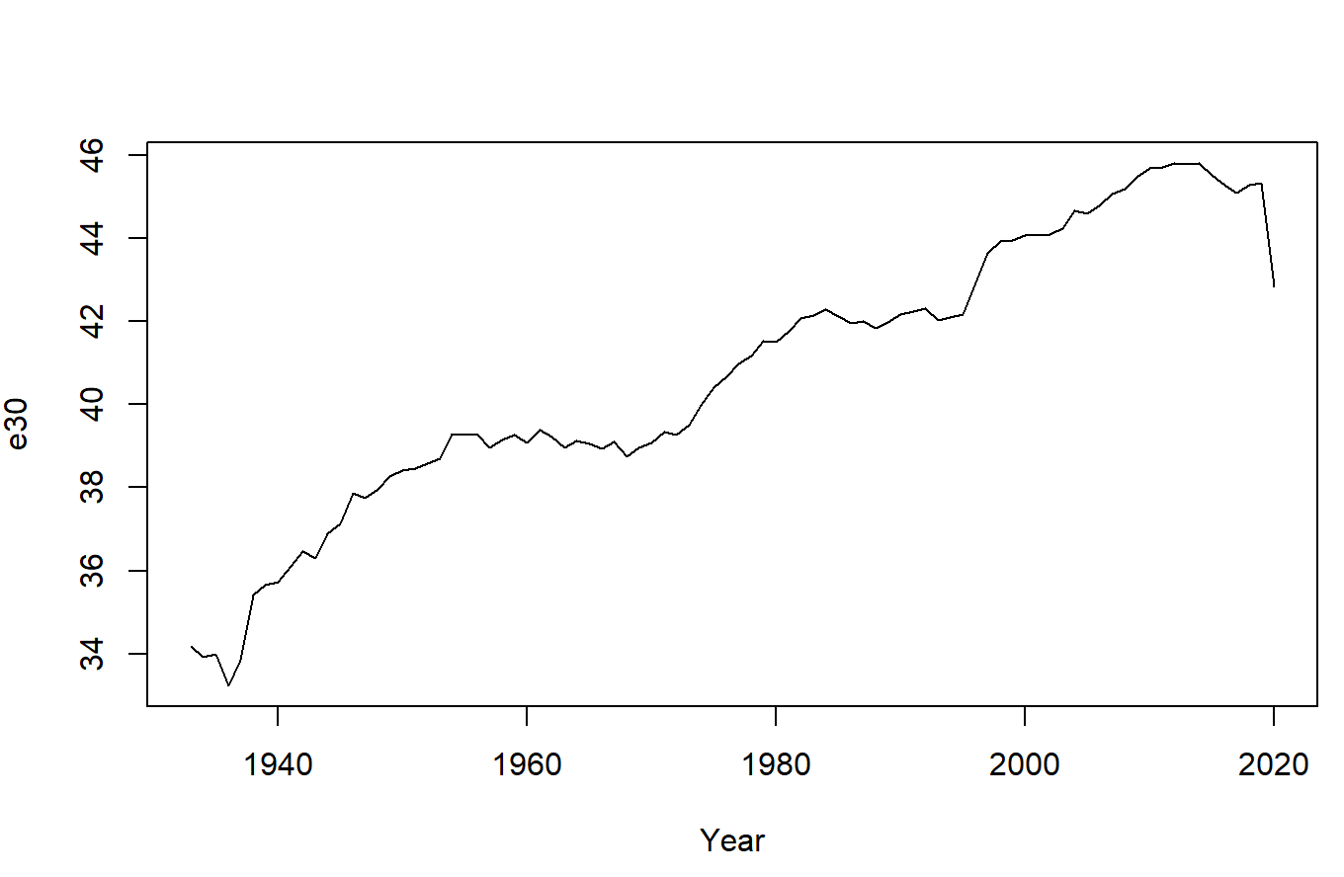
Life expectancy
Geek Version: The average years of life a hypothetical population would live if they follow the mortality of a given year at each age
Plain Version: Measures population health (mortality) at a given year in years
Source: Calculation based on HMD (2022)

Slide 3
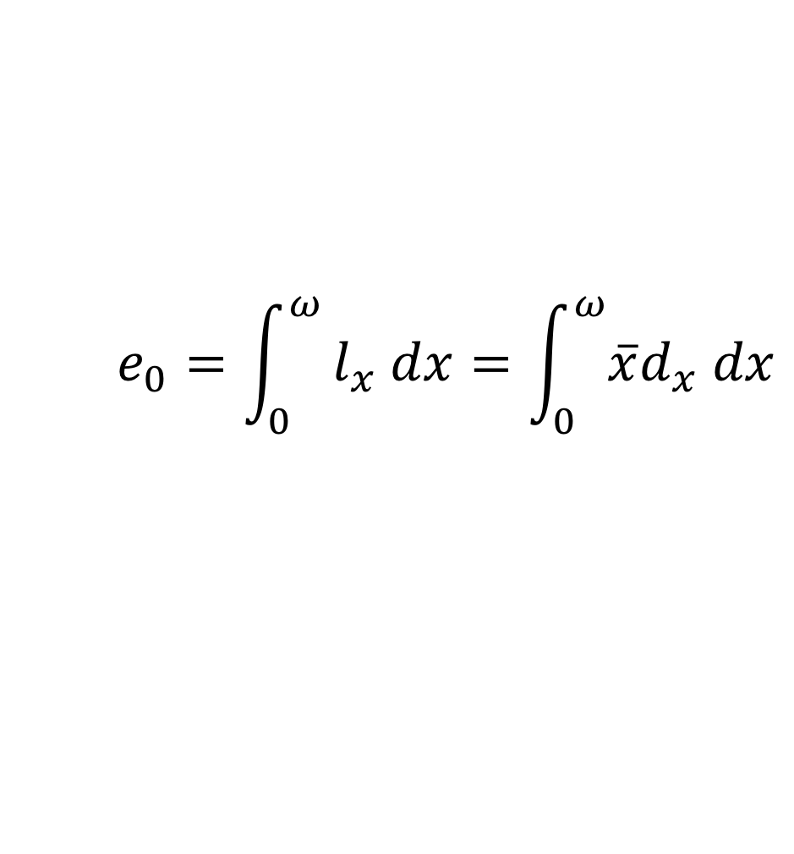
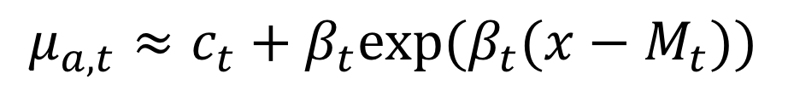
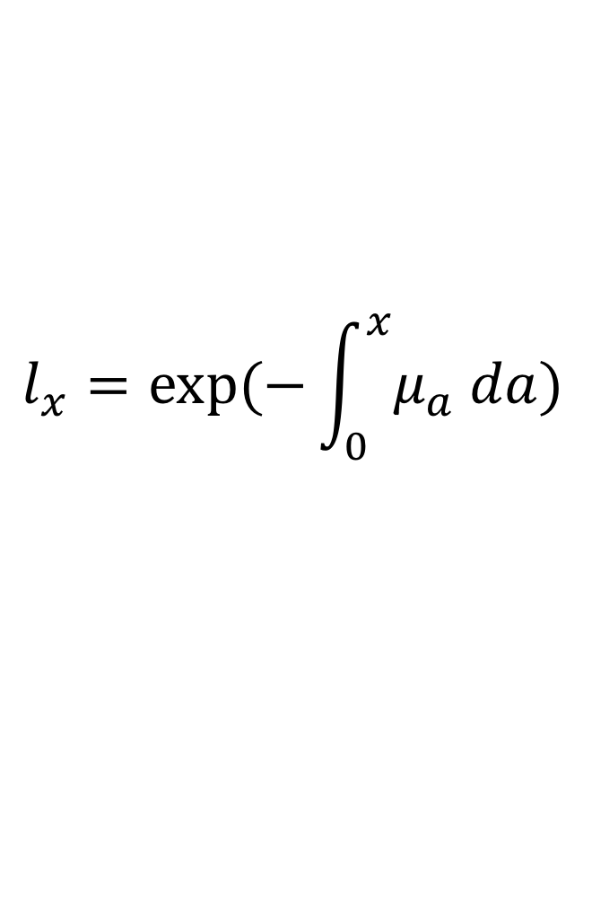
$$e_{0}=\int_{0}^{ω}{l_{x} dx=\int_{0}^{ω}{\overline{x}d_{x} dx}}$$
$$l_{x}=exp⁡(−\int_{0}^{x}{μ_{a} da})$$
$$μ_{a,t}≈c_{t}+β_{t}exp⁡(β_{t}(x−M_{t}))$$
Gompertz-Makeham Model
Parametric Fitting with Maximum Likelihood
Notes:
S

Slide 4
Changes in life expectancy can be traced to:
the changes in age-independent mortality (Background)
the changes in the age-dependent mortality (Compression)
the changes in shift of mortality (Modal age at death)
Question 1: For the United States, which component takes the lead over the years?

Slide 5
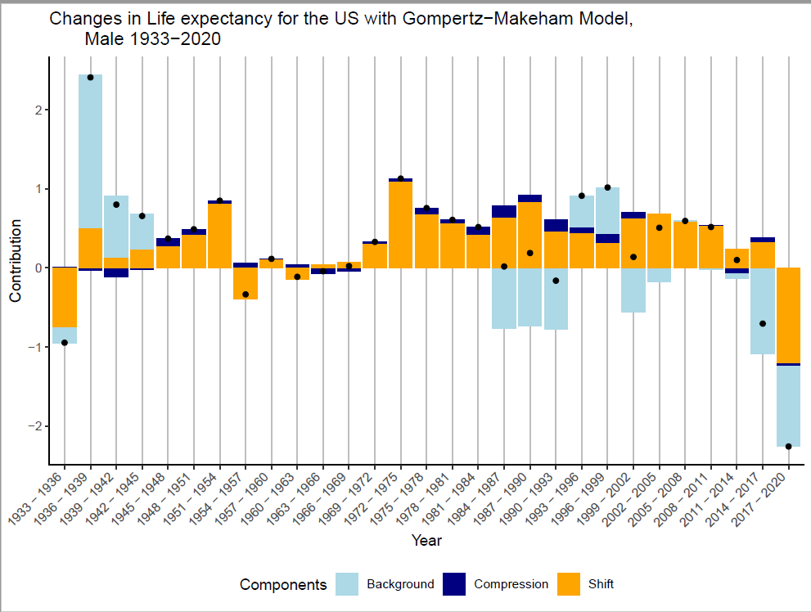
Source: Calculation based HMD (2022)

Slide 6
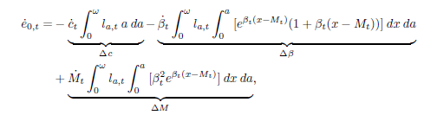
The latest 10 years has seen a significant decrease in life expectancy.
However, does it affect different races equally?
Mid-year smoothed population counts and deaths number from age 30 to age 100 from CDC Wonder database, and the use of the decomposition using Gompartz-Makeham Model

Slide 7
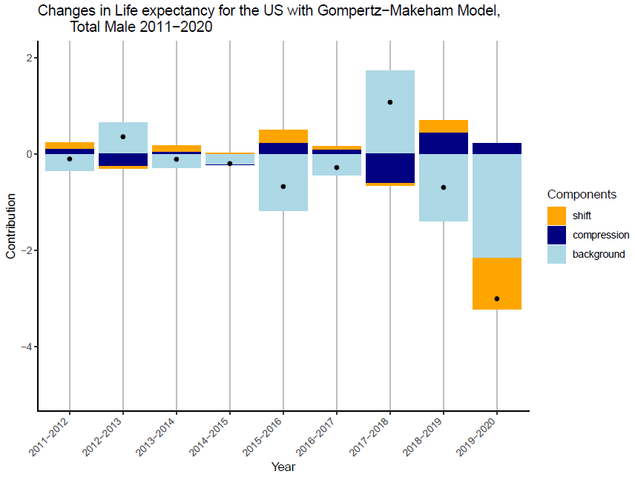
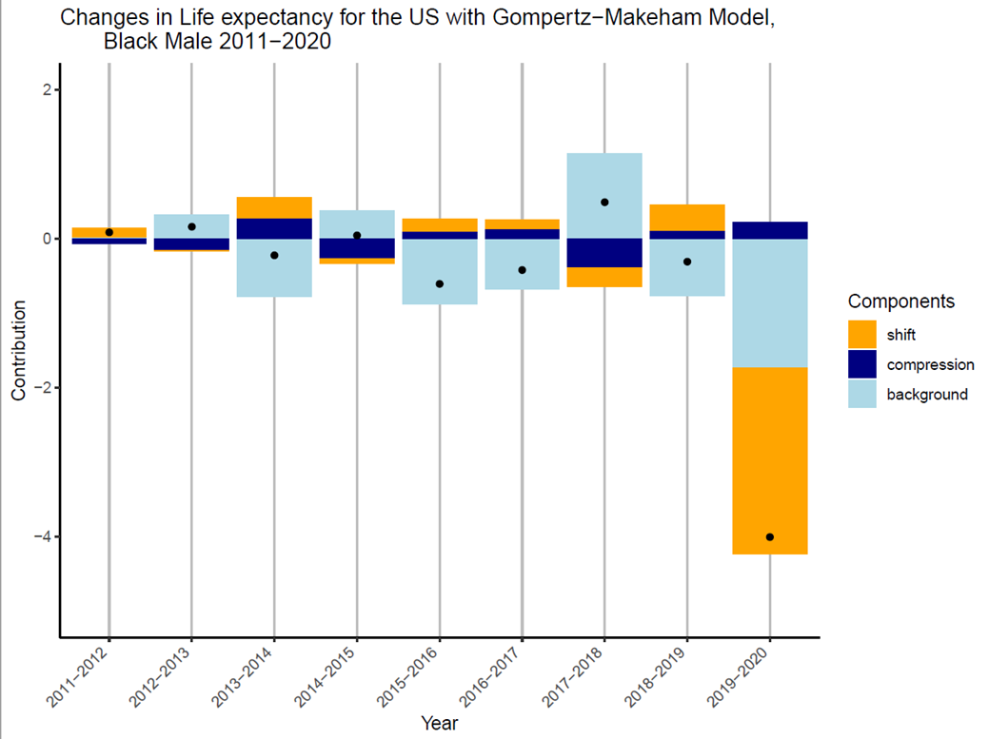
US Average
Blacks
Source: Calculation based on CDC WONDER

Slide 8
Population | Background | Compression | database | Total
Average | -1.5 (-3.6) | 0.1 (0.3) | 0.7 (-0.3) | -0.6 (-3.7)
Blacks | -1.2 (-3.0) | -0.3 (0) | 0.7 (-1.8) | -0.8 (-4.8)
Non-Hispanic Whites | -1.8 (-4.3) | 0.2 (0.5) | 0.7 (0.1) | -1.0 (-3.7)
Native Americans | -1.8 (-3.3) | -0.4 (-0.8) | 1.5 (-1.1) | -0.7 (-5.1)
* Parenthesis marks the 2011-2020 level, while the text marks 2011-2019 level
Notes:
Total -3.63, 0.30, -0.32 (-1.46, 0.08, 0.74)
Blacks -2.96,-0.03, -1.79 (-1.23, -0.25, 0.71)
Non-Hispanic white -4.3, 0.53, 0.07 (-1.78, 0.16, 0.65)
Native -3.26, -0.77, -1.07 (-1.84,-0.39,1.53)
background, compression, shift

Slide 9
Discussion
Mortality inequalities across different races, especially during 1st year of COVID-19 pandemic.
Positive future for longevity growth (shift component), however, there are big setbacks from younger age mortality (age -independent).
Shortcomings
Discrepancies caused by grouping of the race/ethnicity, and under counting of deaths in CDC compared to HMD (Categorical error)
Relative simplistic parametric model, more complexity will infer more insights

